Slide 1
Building Capacity for
Myself and Others
LaTyia Rolle

Slide 2
Objectives for this Workshop
You deserve the opportunity to create a plan that works for you, your team and most importantly your students.
Remember your WHY!
Analyze what’s currently on your plate and what can be taken off
Taking time to think about how NOT to “burn out” while also supporting my teaching team

Slide 3
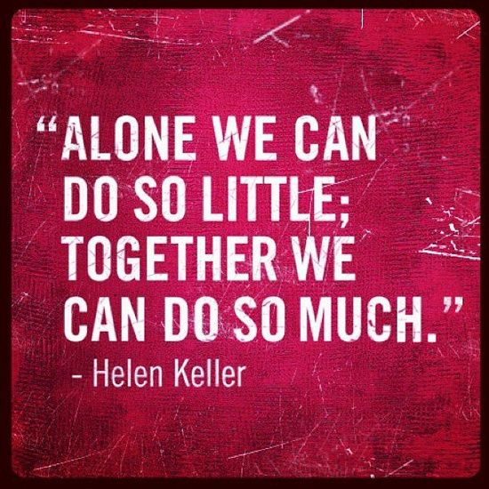

Slide 4
Inspired and Passionate Teachers
What makes an inspired and passionate teacher?
What is currently on your plate?
Who is one person at your site that you can go back and speak with about this?

Slide 5
Collective Teacher Efficacy
John Hattie - Visible Learning
Richard and Rebecca DuFour - Professional Learning Communities
What does this work have in common?
Isolation and silos only cause confusion and a greater workload
Teaching can not be a “one and done”
Collaboration is NOT overrated, it is essential to progress
Shared ownership is ideal for any educational team

Slide 6
Effective ways to begin the work
Norms and Agreements
Create as a team, make sure they include everyone
Commit to using them regularly
Revisit them regularly
Be specific and give descriptions
Be sure to include communication preferences
Nothing is more toxic than repeated disrespectful and dysfunctional meetings

Slide 7
Norms and Agreements
Participate and contribute to the whole group.
Look at your school with an honest and caring eye.
Embrace your dual role as a learner and a teacher.
Be open to new ideas.
Beteiligen Sie sich und leisten Sie einen Beitrag für die gesamte Gruppe.
Betrachten Sie Ihre Schule mit einem ehrlichen und fürsorglichen Auge.
Nehmen Sie Ihre Doppelrolle als Lernender und Lehrender wahr.
Seien Sie offen für neue Ideen.

Slide 8
Norms and Agreements
Communicate using respectful words and tone.
Listen to understand, not to be heard.
Honor every voice.
Set aside distractions.
Kommunizieren Sie mit respektvollen Worten und in respektvollem Ton.
Hören Sie zu, um zu verstehen, nicht um gehört zu werden.
Wertschätzen Sie jede Äußerung.
Vermeiden Sie Ablenkungen.

Slide 9
Meeting Template and Forms
Use a sustainable meeting template form that can be accessed by the entire team
Make sure the note-taker is a shared responsibility
Facilitator can be the team leader, but doesn’t have to be
Remember the best practices for effective PLC’s
Let’s review a sample team meeting template. Consistency is the best way to effectively learn new routines.

Slide 10
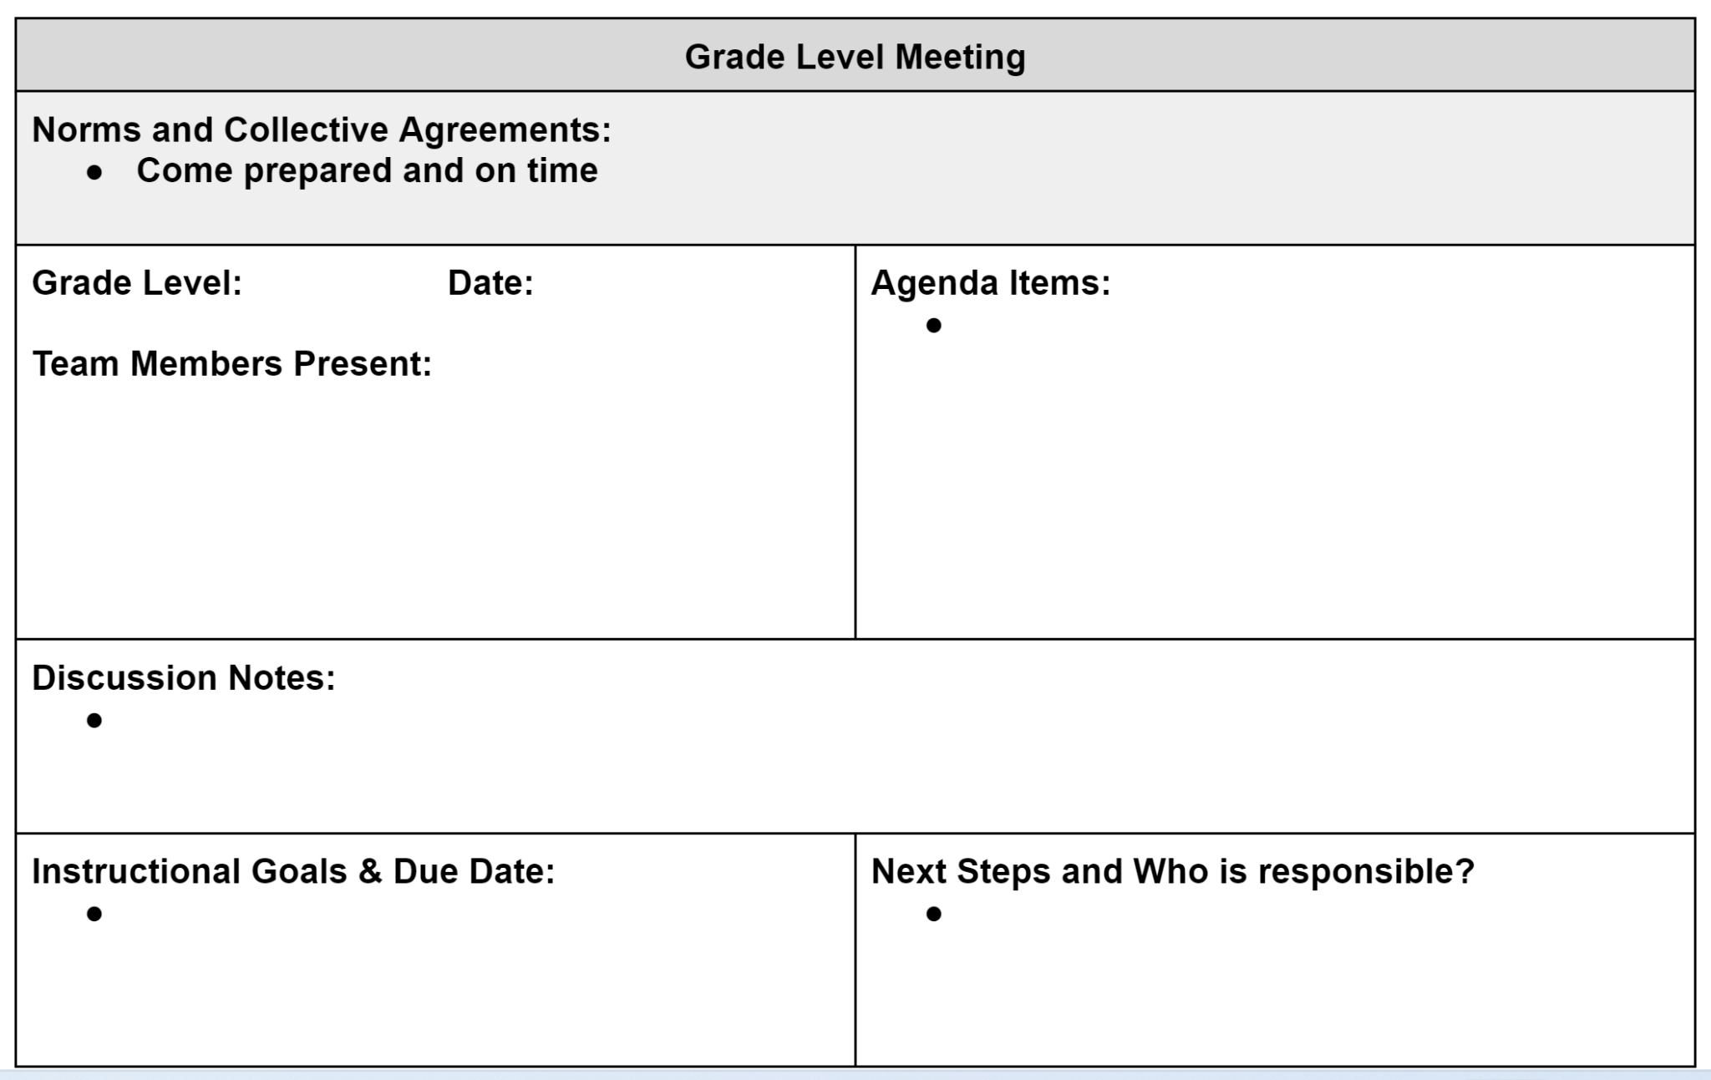

Slide 11
Cultural Differences
Teaching in a country that is different from your own brings on unique challenges and experiences to collective teacher efficacy.
What are some of the major differences between your current teaching climate and the one you received training in?
Is the definition of “a teacher” the same or different?
Cultural fusion can impact teacher teams

Slide 12
Leading your team in efficient discussions about instructional practices
Be purposeful: Analyze the effectiveness of what is happening for students
Am I meeting the needs of my students?
Are students receiving any common learning experiences in the building?
Is there trust amongst my teaching team?
Do we understand the power of feedback? For students and teachers?

Slide 13
Examples
Lesson Studies
Agreed upon teaching strategies
Engagement strategies
Co-created assessment tools
Regular communication that feels good
Quick and effective…no time wasting
Purposeful reminders about doing this work for students
Take ACTION
Accountability

Slide 14
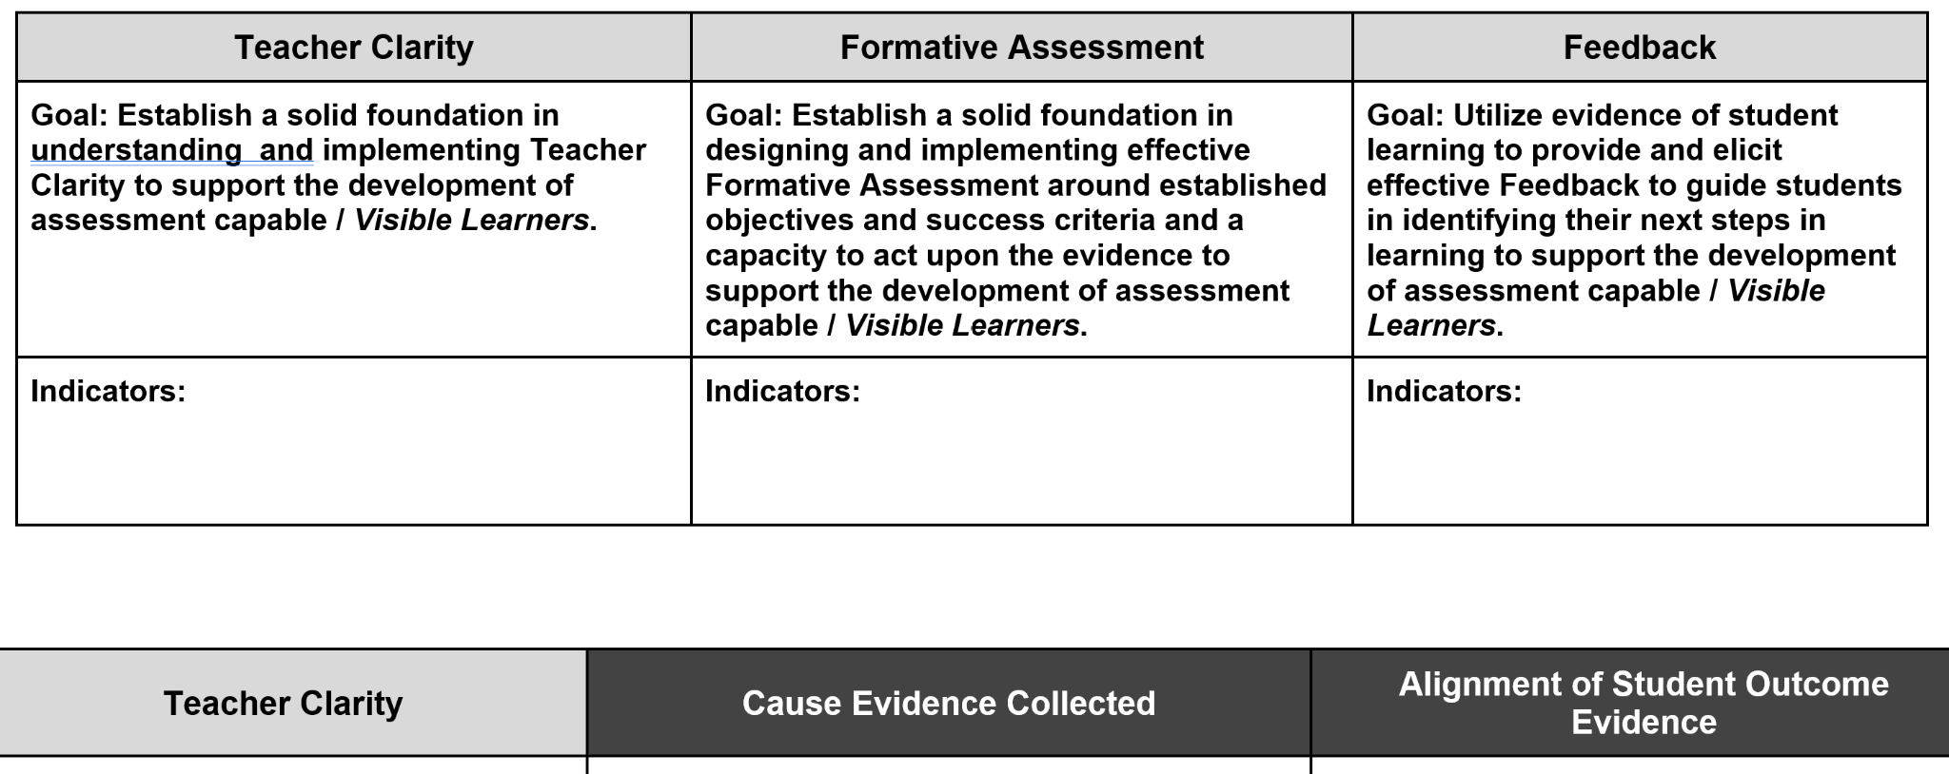
Examples Continued

